Slide 1
A comparative study of utilizing LDA(Latent DirichleT ALLOCATION) topic model for information retrieval
Jie song
College of Information and Computer Sciences
University of Massachusetts Amherst

Slide 2
Outline
Introduction
Experiment Design
Expected Result
Preliminary Data
Further Study

Slide 3
Introduction to Topic model
Assumption:
A document is assumed to draw its vocabulary from one or more topics
Definition:
Topics - represented as probability distributions over the vocabulary
Question:
Are topics are useful to help retrieve documents on the same topic as a query?
Recent study:
Topic model has been successfully applied to large-scale and realistic collections
It also has been claimed that topic models can improve IR by matching queries to documents at a semantic level

Slide 4
Popular topic models
Mixture of Unigrams (MU) model
assumes that there are multiple topics in the corpus and each document is assigned to one of those topics
Latent Dirichlet Allocation (LDA) model
Also assumes that there are multiple topics in the corpus but that a document can have multiple topics
Pachinko Allocation Model (PAM)
explicitly captures the topic correlations by sampling over super-topics – mixture of topics

Slide 5
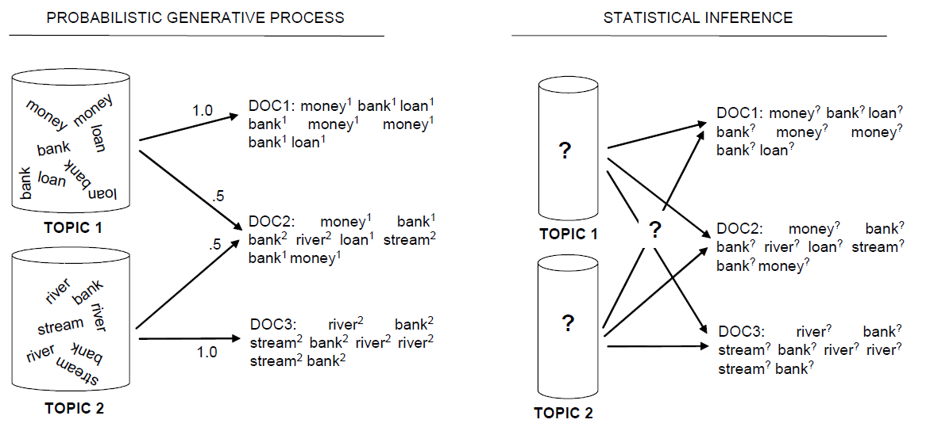
LDA model
LDA is a probabilistic model with a corresponding generative process
The Generative Process
To generate a document:
1. Randomly choose a distribution over topics
2. For each word in the document
randomly choose a topic from the distribution over topics
randomly choose a word from the corresponding topic (distribution over the vocabulary)

Slide 6
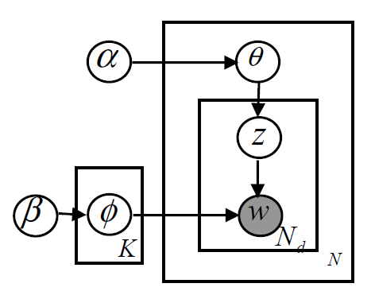
Graphical model representation of LDA
θ: topic multinomial distribution for each document
φ: words mulitinomial distribution for each topic
α: Dirichlet smoothing parameter for θ
β: Dirichlet smoothing parameter for φ
K: number of topics
N: number of documents
N_{d}: number of word tokens in document d

Slide 7

Experiment Design
Data preprocess
Model build
Baseline model:
QL model:
Comparative model:
CBDM (MU model):
LDA model:
LBDM

Slide 8
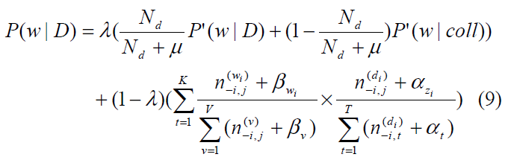
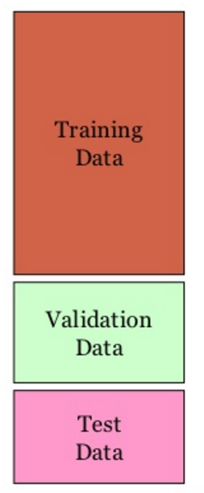
Experiment Design
3. LDA model parameter estimation
method: cross validation
Tune parameter λ and μ
Tune hyperparameter α and β
Validate results

Slide 9
Experiment Design
4. LDA model data process
method: Gibbs Sampling
tool: - MALLET
- Open Source Package of LDA (Liu Yang)
5. Result comparison and evaluation
evaluation metrics: - MAP
- nDCG
- ERR

Slide 10
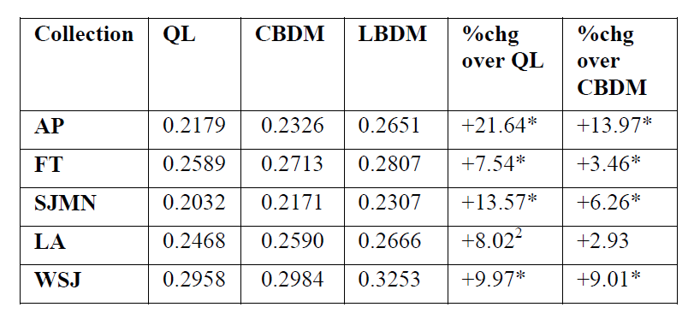
Expect result

Slide 11
Thank you!

